Slide 1
https://powercybertestbed.ece.iastate.edu/
PUSH ALL WORK TO GITLAB AND IN VM!!!!!1!!!

Slide 2
Week 3

Slide 3
Who are Present Today
Justin, Zach, Tyler, Matt, Tommy

Slide 4
Overview of Work

Slide 5
Kaya - Work
Tasks worked on from last week:
1. Master file control time for synchronization in Helics
2. Experiment with the time step for sending and receiving data (doing things super fast, look into an in-between middle time)
3. Bi-directional data transfer

Slide 6
Kaya - Work
1. Master file control time synchronization: Helics doesn’t have this, it’s based on the period you set for each federate. It works by: federate requests time from broker. Broker checks if other federates have finished simulating that time period. If they're done, federate is granted time. If not, it waits.
Ex. Charger simulates charging from 1:00 - 1:01. Asks broker if it can simulate for time 1:01-1:02. Broker checks if other federates have completed their simulation for time 1:00-1:01. If yes, then grants time to the federates. If a federate isn't done yet, the broker tells the other federates to wait.

Slide 7
Kaya - Work
2. Experiment with the time step for sending and receiving data. Helics documentation states that there are basically 3 ways of doing this.
Option 1: Helics documentation states that the highest levels of performance is: single core inside a single multi-threaded application (with typically one thread per federate).
Have to be super careful with this one. Each thread would need to be running something that doesn’t depend on another actively running thread, due to Helics time management system.
Option 2: Helics documentation says for computationally heavy simulations, you may need to spread the federates out across a number of compute nodes to give each federate the resources it needs.
Option 3: Helics documentation also suggests having a root broker, which has sub brokers communicating with it from separate computers. This requires that the federates mainly communicate with the other federates on the same computer, and not much with the ones outside of it.

Slide 8
Kaya - Work
Questions:
Santa fe model, what kind of messages are the 70k busses?? Are they all different or can they be grouped?
If they can be grouped, you assign each grouping its own broker for increased performance. (Battery/charger example just has one broker)
Does everything on the Santa Fe model happen simultaneously, or are there always certain things that run before other things?
Are there portions of the Santa Fe model that can be grouped together, and don’t need to communicate with each other much?

Slide 9
Tyler - Work
Dug some into vulnerabilities, have not found anything yet that would be of use
Problem: The vm’s are not on the same network as each other, so we cannot initiate attacks from one vm to another. A LAN needs to be set up for each of the VM’s to be able to talk to each other. I do not have the permissions for this.
Got LOIC to run on most of the ubuntu vm’s and the kali vm.

Slide 10
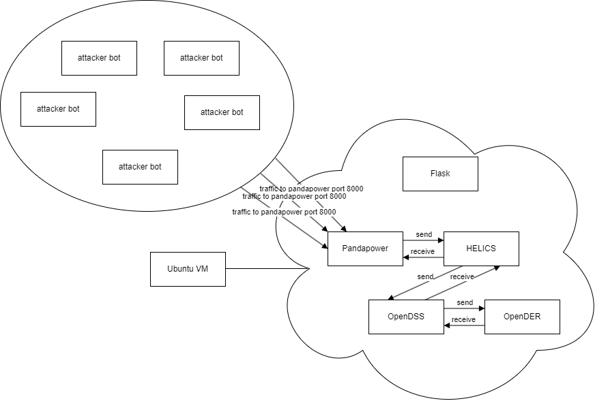
Tyler - Work

Slide 11
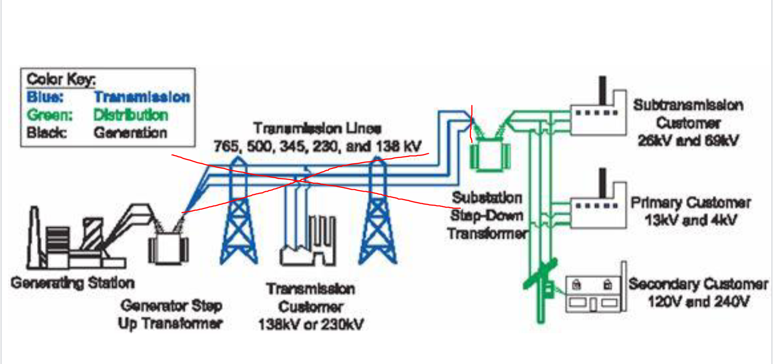
Tyler - Work

Slide 12
Zach - Work/Future Work
Got Wireshark installed on all Ubuntu VMs
Future: Need to create network diagram to understand/create TCP/un-encrypted communication
Created Wireframe for Kali attack website
Continued Kali Attack Website build
Create attacks to deploy on website
Add css to the site
Work with Tyler on specific attack wireframes
Add wireframes to attack website

Slide 13
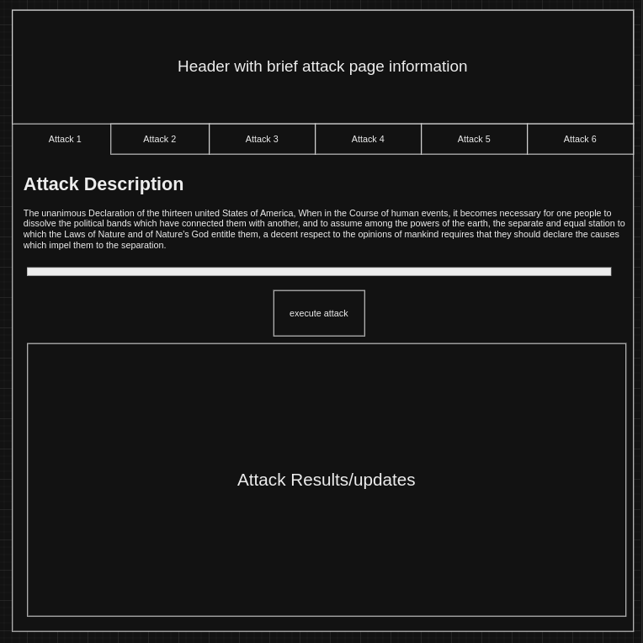
Zach - Work

Slide 14
Justin - Work
Helped Tommy with some Docker trouble
Found a nifty new command: Docker run –rm -it $(docker build -q .)
Still working on getting HELICs to work in the Dockers :/
Lots of Questions on this…
Maybe meet this week?

Slide 15
Tommy Work
Created a script that added a BESS component that activates during peak hours added to IEEE 13 bus distribution on a single bus. Then will plot this single bus using matplotlib
Cannot find the IEEE 13 bus location, may need to download master file and files that go with
Have not attempted to run that code due to precious problem

Slide 16
Tommy Work
Created a python script to solve and run Santa Fe model
Only was ran on windows last semester
Added a function that takes user input to select which buses output voltage to be plotted using matplotlib
Returned error code shown below
Code on VM

Slide 17
Tommy Future Plans
Work with attack team to discuss how we will show impacts of attacks on grid
Begin to use the newly created function to explore the busses on santa fe model and find areas to add new loads (such as EV’s and BESS)

Slide 18
Matt - Work
Explored the fundamental default example from HELICS github
Creates co-simulation between a charger federate and a battery federate
The co-simulation between federates transfers EV_current from the charger to the battery based on it’s SOC
When running, I was not able to get an output
Was able to create a charger.py and battery.py based on the example provided by HELICS

Slide 19
Matt - Work
Was also able to create configuration JSON files for the charger and battery
Do these names need to match was it called in the code? Updated the code with file names that I saved them as and still cannot run.

Slide 20
Matt - Work
Experiencing issues trying to run the runner.json file provided in the example
Does this need to show the entire file path? (tried but did not work, may have used incorrect syntax)
Need help with the “--path=” function in the command window
Once this is solved, simulation should run

Slide 21
Next Week's Plan

Slide 22
Meeting Minutes

